Slide 2
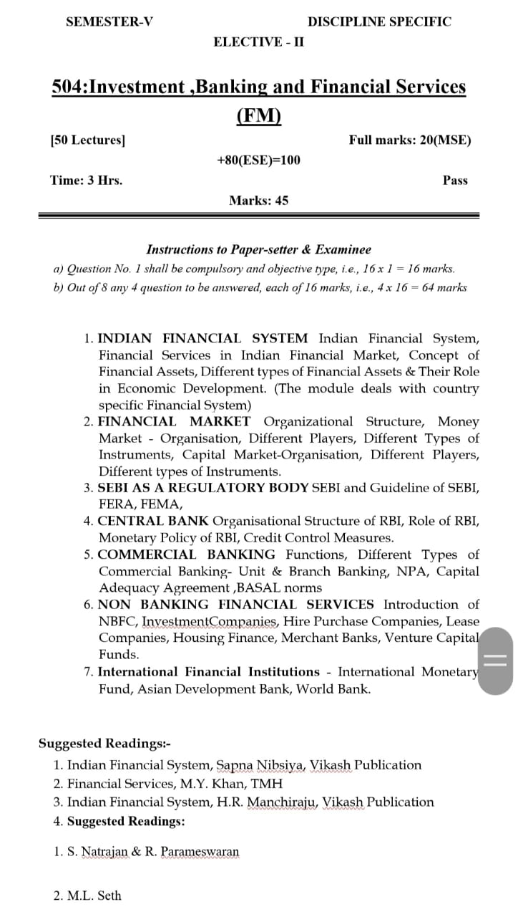

Slide 4
FINANCIAL MANAGEMENT
FINANCING DECISION
INVESTMENT DECISION
DIVIDEND DECISION

Slide 5
INVESTMENT DECISION
SHORT TERM
LONG TERM
WORKING CAPITAL DECISION
CAPITAL BUDGETING DECISION

Slide 6
FINANCING DECISION
SOURCES OF RAISING FUNDS
SHARES
DEBENTURES
LOANS

Slide 7
DIVIDEND DECISION
DISTRIBUTED AMONG SHAREHOLDERS
RETAINED EARNING

